Slide 1


Electric Vehicle Data Quality Analysis Using Tableau Prep and Python
Presented By: Sanjay Pendyala
Guided By:
Jalali, Mehrdad

Slide 2

Introduction
  Data quality is important for accurate analysis.
  Poor-quality data leads to incorrect insights.
  Tableau Prep helps clean and transform data.
  Python helps automate advanced validation.
Page 02

Slide 3

Dataset Description​
  Dataset: Electric Vehicle Population Dataset​
  Contains EV manufacturer, model, range, location, and pricing information.​
  Original dataset size: ~113,000 rows.​
  Fields include Make, Model, Electric Range, State, Vehicle Location, MSRP, etc.​
Page 03

Slide 4
Problem Statement​
  The Electric Vehicle dataset contained duplicate, missing, and inconsistent data.
  These issues affected data quality and analysis accuracy.
  Tableau Prep and Python were used to clean and transform the dataset.
Project Objectives
  Identify data quality issues
  Apply Tableau Prep transformations
  Integrate Python functions using TabPy
  Improve dataset consistency and accuracy
  Generate insights from cleaned data
Page 04

Slide 5
Identified Data Issues
  Identified Problems:
  Duplicate rows
  Missing values
  Invalid Electric Range values
  Base MSRP = 0
  Inconsistent state names
  Mixed coordinate formatting
  Unstructured location data
Tableau Prep Workflow
Workflow Steps:
  Input Step
  Clean Step
  Duplicate Removal
  Filtering Invalid Values
  Calculated Fields
  Python Integration
  Aggregate Step
  Output Step
Page 05

Slide 6
Transformation Steps
Transformations Applied:
  Duplicate Removal
  Filter Electric Range
  Filter Base MSRP
  Standardize Make Names
  Create State Full Name
  Create Vehicle Age
  Convert Datatypes
  Remove Special Characters
  Split Coordinates
  Rename Fields
  Hide Unnecessary Fields
  Aggregate Data
Page 06

Slide 7
Duplicate Removal
Problem:
Duplicate vehicle records existed in the dataset.
Solution:
  Used ‘Identify Duplicate Rows’
  Filtered to keep only unique records
Filtering Invalid Values
Invalid Values Removed:
  Electric Range = 0
  Base MSRP = 0
Reason:
These values were considered invalid for analysis.
Page 07

Slide 8
Calculated Fields
Calculated Field 1:
State Full Name
Example:
  WA → Washington
  OR → Oregon
Calculated Field 2:
Vehicle Age
Formula: 2026 - Model Year
Coordinate Splitting
Problem:
Vehicle coordinates were stored in combined format.
Solution:
  Removed unnecessary characters
  Split longitude and latitude values
Page 08

Slide 9
Python Integration
Python Integration:
  Used TabPy
  Connected Tableau Prep to Python
  Used Pandas library
Python Functions:
  Missing Value Detection
  Outlier Detection
Page 09

Slide 10
Python Function 1
  Missing Value Detection​
  Purpose: Detect rows containing null values.​
  Output field: Missing_Check​
  Python was used to automate missing-valueanalysis.​
Python Function 2
  Outlier Detection​
  Purpose: Identify abnormal Electric Rangevalues.​
  Output field: Outlier_Flag​
  Statistical logic using mean and standarddeviation was applied.
Page 10

Slide 11
Aggregate Step
Aggregation:
Grouped data by manufacturer.
Result:
Calculated EV count by manufacturer.
Final Cleaned Dataset
Improvements Made:
  Duplicate records removed
  Invalid values filtered
  Coordinates separated
  State names standardized
  Vehicle age calculated
  Data consistency improved
Page 11

Slide 12
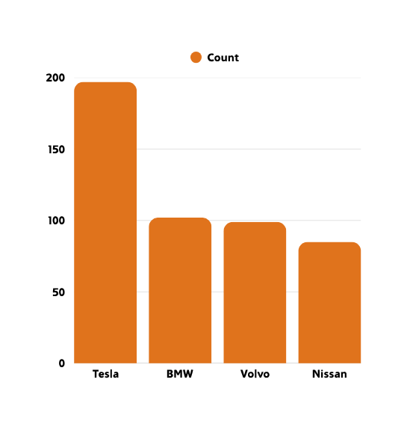
Insights and Findings
Key Insights:
  Tesla had the highest EV registrations
  Washington had the highest EV population
  Most EV ranges were normal
  Data quality improved significantly
Tesla had highest EV registrations
Page 12

Slide 13



Conclusion
  Successfully cleaned EV dataset
  Applied 10+ Tableau Prep transformations
  Integrated Python automation
  Improved data quality and consistency
  Learned practical data-cleaning skills
Page 13

Slide 14


Thank You
Page 14

